Slide 1



Cross-platform reversing with
at NoConName
December 2015
by oleavr

Slide 2
Who am I?
My name is Ole André Vadla Ravnås
Author of Frida, CryptoShark, oSpy, libmimic...
Developer, Hacker and Reverse Engineer
Currently working at NowSecure
Doing R+D on mobile platforms

Slide 3
DEMO

Slide 4
Motivation
Existing tools often not a good fit for the task at hand
Creating a new tool usually takes too much effort
Short feedback loop: reversing is an iterative process
Use one toolkit for multi-platform instrumentation
To build a future remake of oSpy

Slide 5
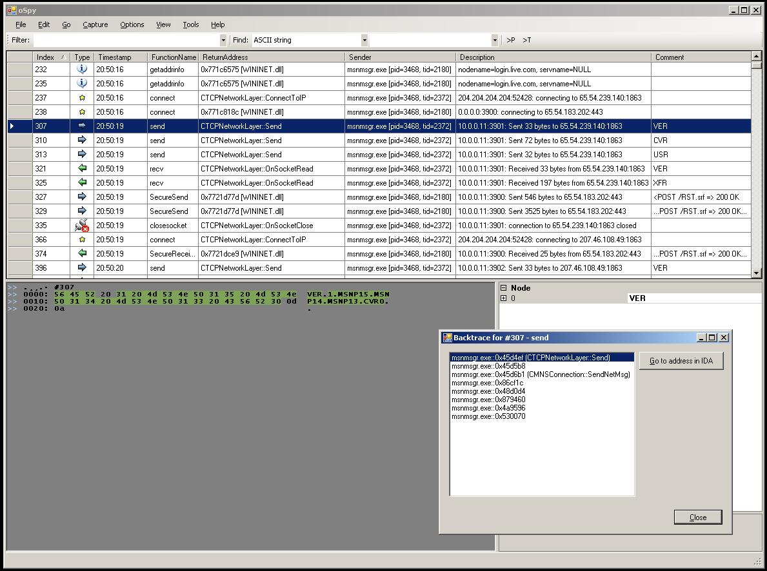
oSpy

Slide 6
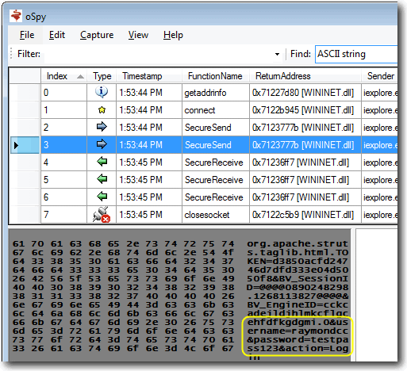
oSpy

Slide 7
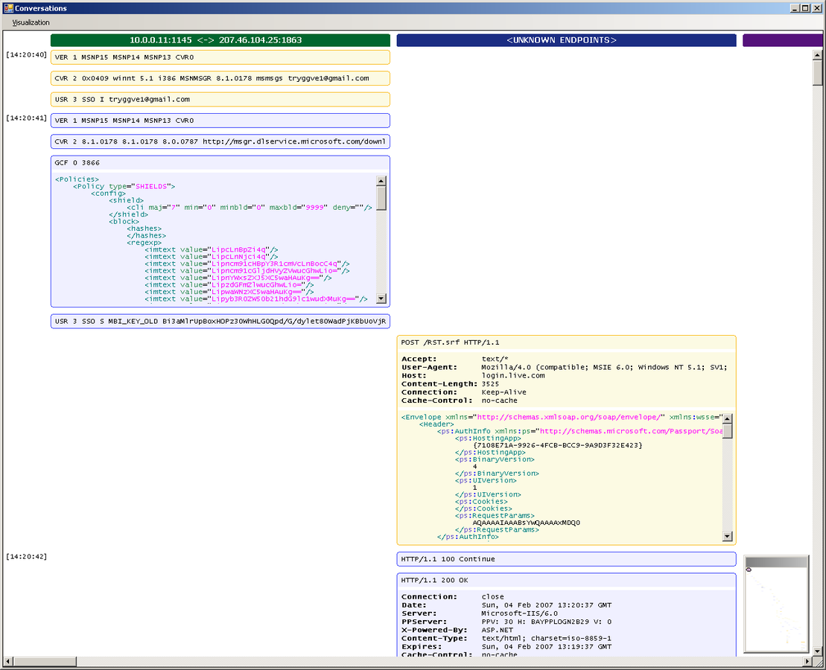
oSpy

Slide 8
What is Frida?
Dynamic instrumentation toolkit
Debug live processes
Scriptable
Execute your own debug scripts inside another process
Multi-platform
Windows, Mac, Linux, iOS, Android, QNX
Open Source

Slide 9
Why Frida?
Runs on all major platforms
No system modifications required
Scriptable
Language bindings for Python, Node.js, .NET, Qt/Qml, etc.
Designed for stealth, does its best to avoid debugging APIs
Fast and lightweight, instrumentation core is only 50 kB on iOS/ARM
Mobile instrumentation without jailbreak
Modular
License allows building closed-source software

Slide 10
Installation
From VM on thumb drive
Install VirtualBox
Copy the provided frida-workshop-vm.tar.gz
Boot it up and log in
User: frida
Password: Frida 1337
Locally
git clone https://github.com/frida/frida-presentations.git
pip install frida
npm install co frida frida-load

Slide 11
Overview
Frida is a toolkit
Install the frida python package to get:
Some useful CLI tools
frida-ps
frida-trace
frida-discover
Frida
Python API
Install the frida Node.js module from npm to get:
Node.js API

Slide 12
Let's explore the basics
1) Build and run the test app that we will instrument:
#include <stdio.h>
#include <unistd.h>
Void
f (int n)
{
printf ("Number: %d\n", n);
}
Int
main ()
{
int i = 0;
printf ("f() is at %p\n", f);
while (1)
{
f (i++);
sleep (1);
}
}
$ clang hello.c -o hello
$ ./hello
f() is at 0x106a81ec0
Number: 0
Number: 1
Number: 2
…
2) Make note of the
address of f(), which is
0x106a81ec0 here.

Slide 13
Basics 1/7: Hooking f() from Node.js
'use strict’;
const co = require('co');
const frida = require('frida');
const load = require('frida-load');
let session, script;
co(function *() {
session = yield frida.attach('hello');
const source = yield load(require.resolve('./agent.js'));
script = yield session.createScript(source);
script.events.listen('message', message => {
console.log(message);
});
yield script.load();
});
$ # install Node.js 5.1
$ npm install co frida frida-load
$ node app.js
{ type: 'send', payload: 531 }
{ type: 'send', payload: 532 }
…
'use strict’;
Interceptor.attach(ptr('0x106a81ec0'), {
onEnter(args) {
send(args[0].toInt32());
}
});
Address of f() goes here

Slide 14
Basics 1/7: Hooking f() from Python
import frida
import sys
session = frida.attach(“hello”)
script = session.create_script(”””
Interceptor.attach(ptr("0x106a81ec0"), {
onEnter(args) {
send(args[0].toInt32());
}
});
”””)
def on_message(message, data):
print(message)
script.on('message', on_message)
script.load()
sys.stdin.read()
Address of f() goes here
$ pip install frida
$ python app.py
{'type': 'send', 'payload': 531} {'type': 'send', 'payload': 532}
…
Notes:
There are also language-bindings for QML, .NET, etc. The API is the same except for local conventions like create_script() vs createScript().
We will stick to the Node.js bindings for the remainder of this workshop.

Slide 15
Basics 2/7: Modifying function arguments
'use strict’;
const co = require('co');
const frida = require('frida');
const load = require('frida-load');
let session, script;
co(function *() {
session = yield frida.attach('hello’);
const source = yield load(require.resolve('./agent.js'));
script = yield session.createScript(source);
yield script.load();
});
$ node app.js
Number: 1281
Number: 1282
Number: 1337
Number: 1337
Number: 1337
Number: 1337
Number: 1296
Number: 1297
Number: 1298
…
Once we stop it
the target is back to
normal
'use strict’;
Interceptor.attach(ptr('0x106a81ec0'), {
onEnter(args) {
args[0] = ptr("1337");
}
});
Address of f() goes here

Slide 16
Basics 3/7: Calling functions
'use strict’;
const co = require('co');
const frida = require('frida');
const load = require('frida-load');
let session, script;
co(function *() {
session = yield frida.attach('hello’);
const source = yield load(require.resolve('./agent.js'));
script = yield session.createScript(source);
yield script.load();
yield session.detach();
});
$ node app.js
Number: 1281
Number: 1282
Number: 1911
Number: 1911
Number: 1911
Number: 1283
Number: 1284
Number: 1285
…
'use strict’;
const f = new NativeFunction(
ptr(’0x10131fec0’), ‘void’, ['int']);
f(1911);
f(1911);
f(1911);
Address of f() goes here

Slide 17
Basics 4/7: Sending messages
'use strict’;
const co = require('co');
const frida = require('frida');
const load = require('frida-load');
let session, script;
co(function *() {
session = yield frida.attach('hello');
const source = yield load(require.resolve('./agent.js'));
script = yield session.createScript(source);
script.events.listen('message', message => {
console.log(message);
});
yield script.load();
});
$ node app.js
{ type: 'send’,
payload: { user: { name: 'john.doe' }, key: '1234' } }
{ type: 'error’,
description: 'ReferenceError: oops is not defined’,
stack: 'ReferenceError: oops is not defined\n at Object.1 (agent.js:10:1)\n at s (../../node_modules/browser-pack/_prelude.js:1:1)\n at e (../../node_modules/browser-pack/_prelude.js:1:1)\n at ../../node_modules/browser-pack/_prelude.js:1:1’,
fileName: 'agent.js’,
lineNumber: 10,
columnNumber: 1
}
'use strict’;
send({
user: {
name: 'john.doe’
},
key: '1234’
});
oops;

Slide 18
Basics 5/7: Receiving messages
'use strict’;
const co = require('co');
const frida = require('frida');
const load = require('frida-load');
let session, script;
co(function *() {
session = yield frida.attach('hello');
const source = yield load(require.resolve('./agent.js'));
script = yield session.createScript(source);
script.events.listen('message', message => {
console.log(message);
});
yield script.load();
yield script.postMessage({ magic: 21 });
yield script.postMessage({ magic: 12 });
});
$ node app.js
{ type: 'send', payload: 42 }
{ type: 'send', payload: 36 }
'use strict’;
let i = 2;
function handleMessage(message) {
send(message.magic * i);
i++;
recv(handleMessage);
}
recv(handleMessage);

Slide 19
Basics 6/7: Blocking receives
'use strict’;
const co = require('co');
const frida = require('frida');
const load = require('frida-load');
let session, script;
co(function *() {
session = yield frida.attach('hello');
const source = yield load(require.resolve('./agent.js'));
script = yield session.createScript(source);
script.events.listen('message', message => {
const number = message.payload.number;
script.postMessage({ number: number * 2 });
});
yield script.load();
});
$ node app.js
Number: 2183
Number: 2184
Number: 4370
Number: 4372
Number: 4374
Number: 4376
Number: 4378
Number: 2190
Number: 2191
Number: 2192
…
Once we stop it
the target is back to
normal
'use strict’;
Interceptor.attach(ptr('0x106a81ec0'), {
onEnter(args) {
send({ number: args[0].toInt32() });
const op = recv(reply => {
args[0] = ptr(reply.number);
});
op.wait();
}
});
Address of f() goes here

Slide 20
Basics 7/7: RPC
'use strict’;
const co = require('co');
const frida = require('frida');
const load = require('frida-load');
let session, script;
co(function *() {
session = yield frida.attach('hello');
const source = yield load(require.resolve('./agent.js'));
script = yield session.createScript(source);
yield script.load();
const api = yield script.getExports();
const result = yield api.disassemble('0x106a81ec0');
console.log(result);
yield session.detach();
});
$ node app.js
push rbp
$
Address of f() goes here
'use strict’;
rpc.exports = {
disassemble(address) {
return Instruction.parse(ptr(address)).toString();
}
};

Slide 21
Launch and spy on iOS app
'use strict’;
const co = require('co');
const frida = require('frida');
const load = require('frida-load');
let session, script;
co(function *() {
const device = yield frida.getUsbDevice();
const pid = yield device.spawn(['com.apple.AppStore']);
session = yield device.attach(pid);
const source = yield load( require.resolve('./agent.js'));
script = yield session.createScript(source);
script.events.listen('message', message => {
if (message.type === 'send' && message.payload.event === 'ready’)
device.resume(pid);
else
console.log(message);
});
yield script.load();
})
.catch(console.error);
$ node app.js
{ type: 'send', payload: { event: 'call', name: 'CC_MD5' } }
{ type: 'send', payload: { event: 'call', name: 'CCDigest' } }
{ type: 'send', payload: { event: 'call', name: 'CNEncode' } }
…
'use strict';
Module.enumerateExports('libcommonCrypto.dylib', {
onMatch(e) {
if (e.type === 'function') {
try {
Interceptor.attach(e.address, {
onEnter(args) {
send({ event: 'call', name: e.name });
}
});
} catch (error) {
console.log('Ignoring ' + e.name + ': ' + error.message);
}
}
},
onComplete() {
send({ event: 'ready' });
}
});

Slide 22
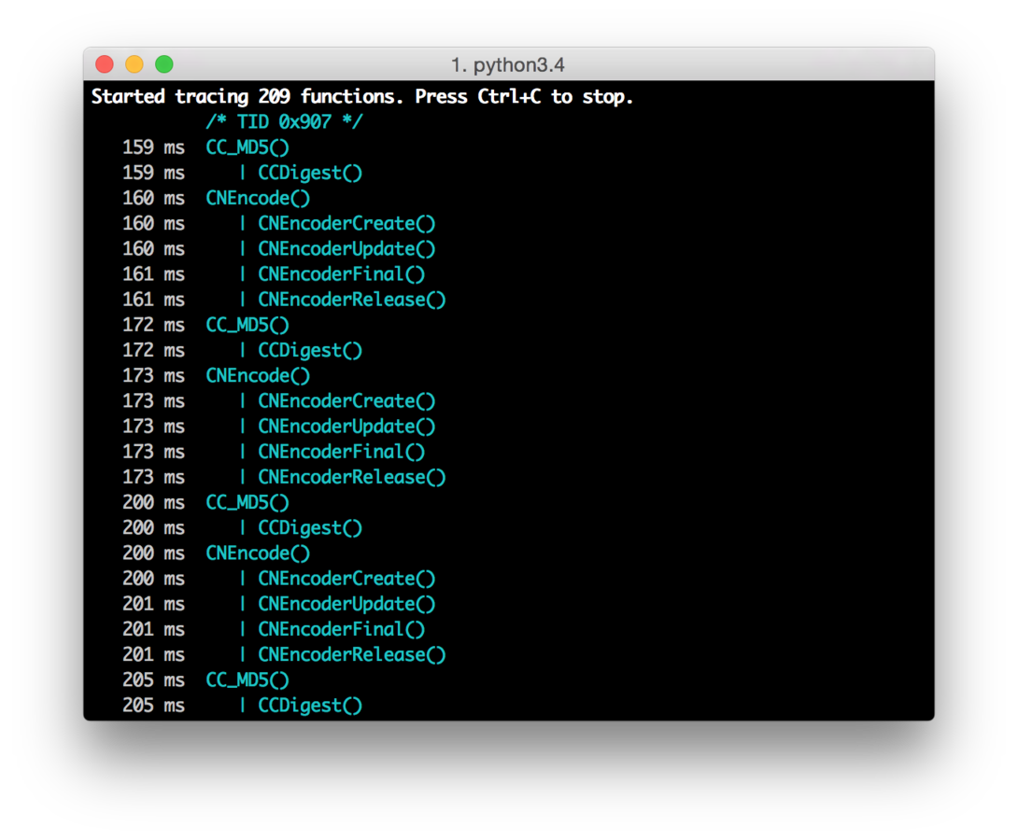
But there’s an app for that
$ sudo easy_install frida
$ frida-trace -U -f com.apple.AppStore -I libcommonCrypto.dylib
Notes:
Show that auto-generated .js can be live-edited.

Slide 23
Dump iOS UI
'use strict’;
const co = require('co');
const frida = require('frida');
const load = require('frida-load');
let session, script;
co(function *() {
const device = yield frida.getUsbDevice();
const app = yield device.getFrontmostApplication();
if (app === null)
throw new Error("No app in foreground");
session = yield device.attach(app.pid);
const source = yield load(require.resolve('./agent.js'));
script = yield session.createScript(source);
script.events.listen('message', message => {
console.log(message.payload.ui);
session.detach();
});
yield script.load();
});
$ node --harmony dump-ui.js
<UIWindow: 0x15fe3ca40; frame = (0 0; 375 667); autoresize = W+H; gestureRecognizers = <NSArray: 0x17424c1e0>; layer = <UIWindowLayer: 0x17023dcc0>>
| <UIView: 0x15fd2dbd0; frame = (0 0; 375 667); autoresize = W+H; layer = <CALayer: 0x174432320>>
| | <UIView: 0x15fe64250; frame = (0 0; 375 667); autoresize = W+H; layer = <CALayer: 0x170235340>>
| | | <UIView: 0x15fd506e0; frame = (0 0; 375 667);
…
'use strict’;
ObjC.schedule(ObjC.mainQueue, () => {
const window = ObjC.classes.UIWindow.keyWindow();
const ui = window.recursiveDescription().toString();
send({ ui: ui });
});

Slide 24
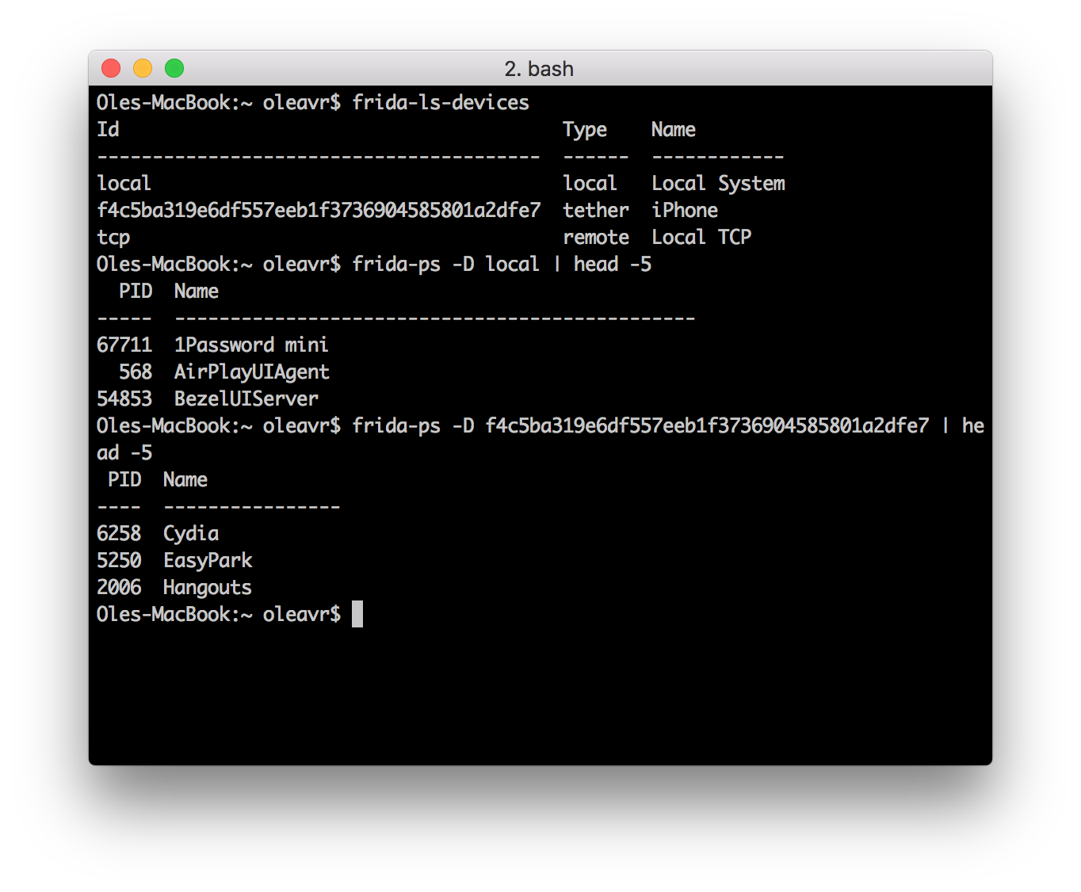
Hold on a sec, what if I have many phones connected?
Notes:
Show that auto-generated .js can be live-edited.

Slide 25
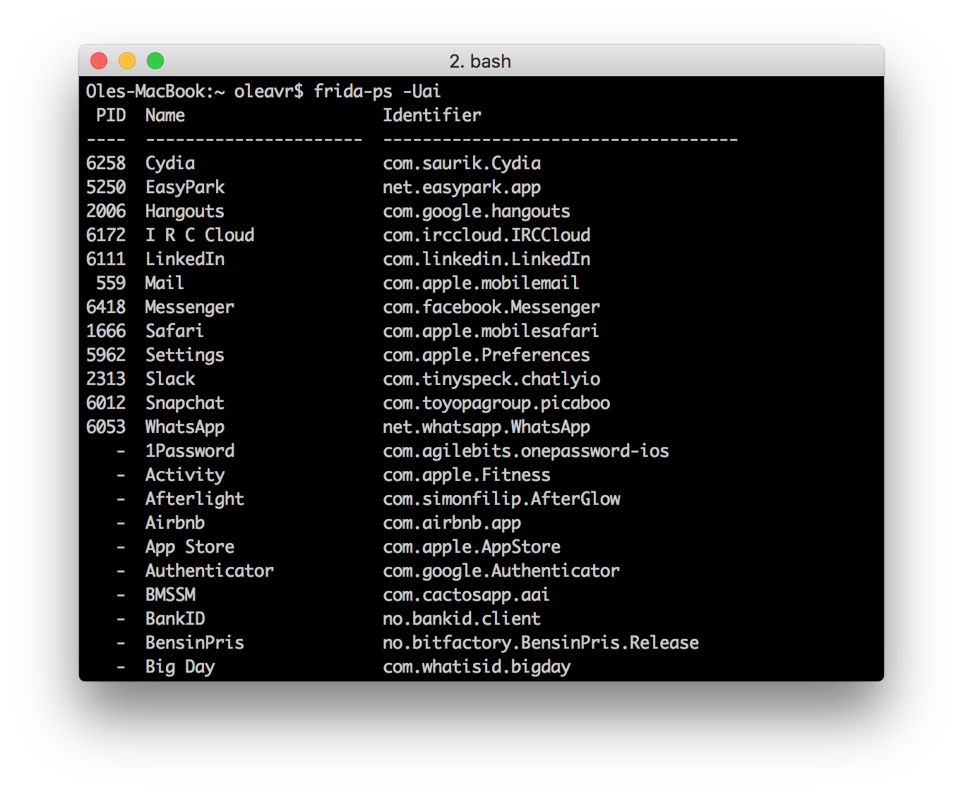
Which apps are installed?
Notes:
Show that auto-generated .js can be live-edited.

Slide 26
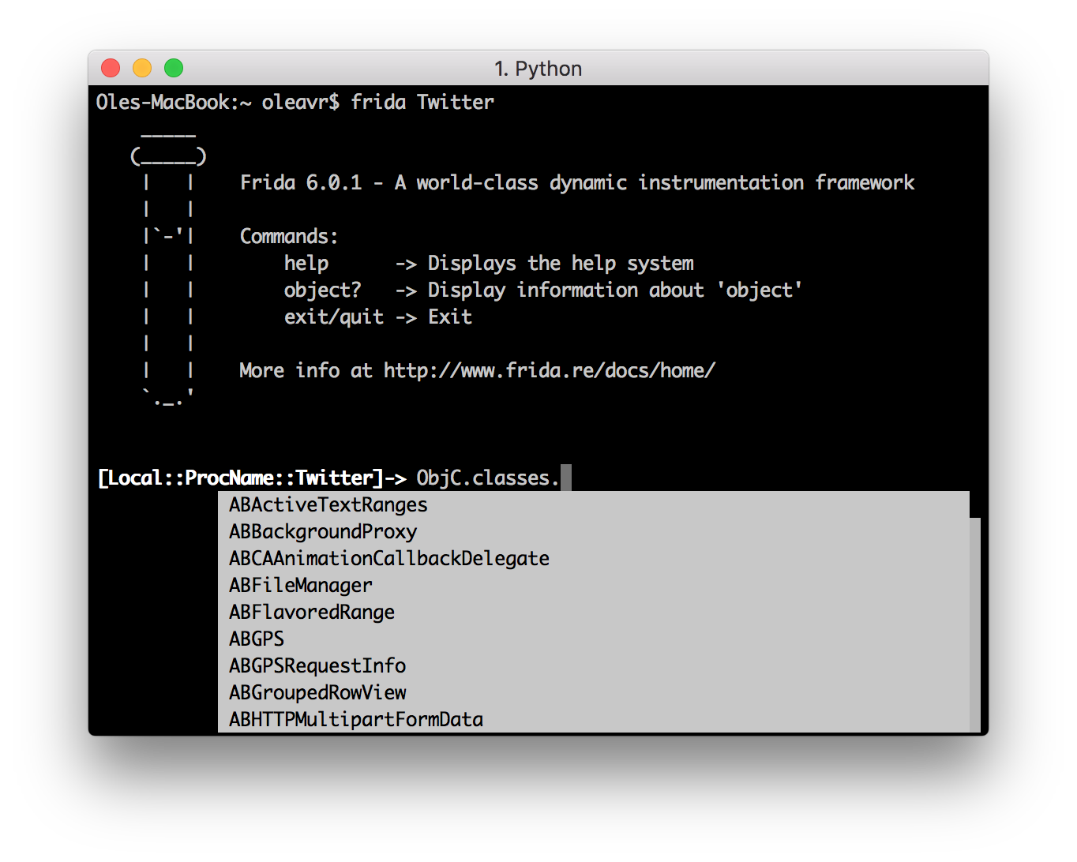
Speaking of apps, we also have a REPL:

Slide 27
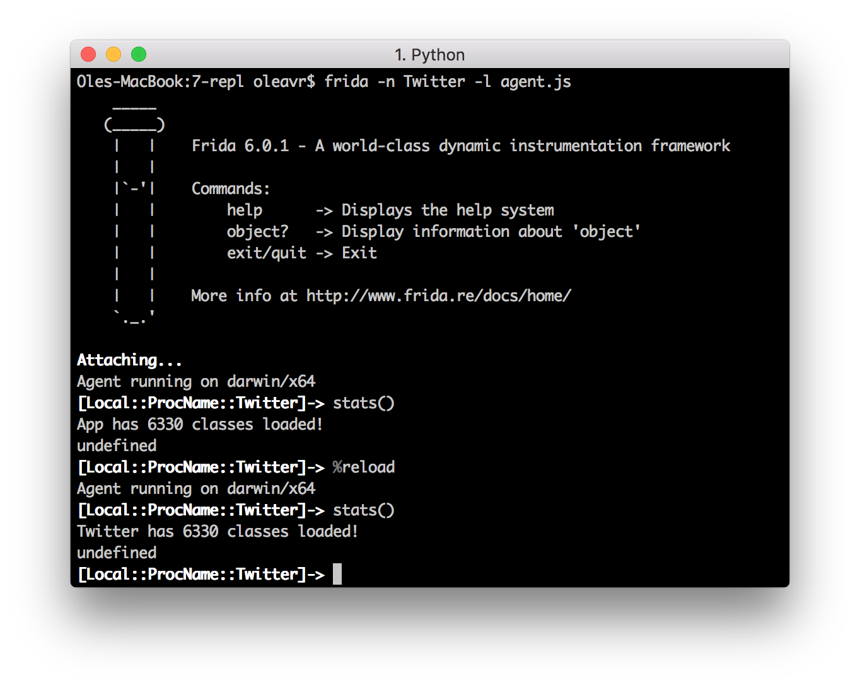
The REPL is your best friend for prototyping scripts

Slide 28
Uninstall iOS app
'use strict’;
const LSApplicationWorkspace = ObjC.classes.LSApplicationWorkspace;
const onProgress = new ObjC.Block({
retType: 'void’,
argTypes: ['object'],
implementation: (progress) => {
console.log('onProgress: ' + progress);
}
});
function uninstall(appId) {
const workspace = LSApplicationWorkspace.defaultWorkspace();
return workspace.uninstallApplication_withOptions_usingBlock_(appId, null, onProgress);
}
$ frida –U SpringBoard –l agent.js

Slide 29
Interacting with Objective-C
ObjC.available – is the runtime present?
new ObjC.Object(ptr(‘0x1234’)) – interact with object at 0x1234
ObjC.classes – all loaded classes
Object.keys(ObjC.classes) to list all names
if (‘UIView’ in ObjC.classes) to check for class presence
ObjC.protocols – all loaded protocols
[NSURL URLWithString:foo relativeToURL:bar] translates to ObjC.classes.NSURL.URLWithString_relativeToURL_(foo, bar)
NSURL[‘- setResourceValues:error:’] to access instance methods from its class
Assign to .implementation to replace a method
ObjC.choose() – scan heap looking for Objective-C instances

Slide 30
Hooking Objective-C methods
The swizzling way:
const method = ObjC.classes.AVAudioSession['- setCategory:error:'];
const originalImpl = method.implementation;
method.implementation = ObjC.implement(method, function (self, sel, category, error) {
return originalImpl(self, self, category, error);
});
The low-level way:
const method = ObjC.classes.AVAudioSession['- setCategory:error:'];
Interceptor.attach(method.implementation, {
onEnter(args) {
},
onLeave(retval) {
}
});

Slide 31
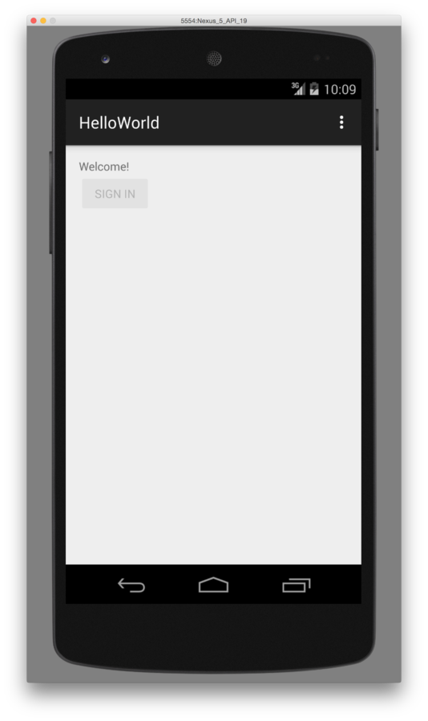
Android instrumentation
'use strict’;
const co = require('co');
const frida = require('frida');
const load = require('frida-load');
let session, script;
co(function *() {
const device = yield frida.getUsbDevice();
session = yield device.attach('re.frida.helloworld');
const source = yield load(require.resolve('./agent.js'));
script = yield session.createScript(source);
script.events.listen('message', message => {
console.log(message);
});
yield script.load();
});
'use strict’;
Dalvik.perform(() => {
const MainActivity = Dalvik.use(
're.frida.helloworld.MainActivity');
MainActivity.isRegistered.implementation = () => {
console.log('isRegistered() w00t');
return true;
};
});

Slide 32
Interacting with Java
Java.available – is the runtime present?
Java.perform(fn) – interact with the Java VM from the given callback
Java.cast(ptr(‘0x1234’), Java.use(“android.os.Handler”)) – interact with object at 0x1234
Constructors are exposed as $new(), and overloads can be selected as with any methods:
Handler.$new.overload("android.os.Looper").call(Handler, looper)
Java.enumerateLoadedClasses() – all loaded classes
Assign to .implementation to replace a method
Java.choose() – scan heap looking for Java instances

Slide 33
Hooking Java methods
const Handler = classFactory.use("android.os.Handler");
Handler.dispatchMessage.implementation = function (msg) {
// Chain up to the original implementation
this.dispatchMessage(msg);
};
Notes:
Optimized for Dalvik on Android 4.4. ART support for hooking is not yet ready.

Slide 34
Early instrumentation
pid = frida.spawn([“/bin/ls”])
session = frida.attach(pid)
script = session.create_script(“your script”)
<apply instrumentation> – recommend RPC for this: script.exports.init()
frida.resume(pid) – application’s main thread will enter main()
For mobile apps specify its identifier: spawn([“com.apple.AppStore”])
Forgot what it was? Use frida-ps -ai

Slide 35
How about implicitly spawned processes? Enter spawn gating!
device.on(‘spawned’, on_spawned)
device.enable_spawn_gating()
device.enumerate_pending_spawns()
Examples:
https://gist.github.com/oleavr/ae7bcbbb9179852a4731
Only implemented for iOS and Android.

Slide 36
Backtraces
'use strict’;
Interceptor.attach(Module.findExportByName('libSystem.B.dylib', 'connect'), {
onEnter() {
console.log('connect called from:\n\t' +
Thread.backtrace(this.context, Backtracer.ACCURATE).join('\n\t'));
}
});
$ frida –n Spotify -l agent.js
[Local::PID::66872]-> connect called from: 0x106de3a36 0x106de6851 0x10753d092 0x10753ecd1
Notes:
Optimized for Dalvik on Android 4.4. ART support for hooking is not yet ready.

Slide 37
Backtraces with debug symbols
'use strict’;
Interceptor.attach(Module.findExportByName('libSystem.B.dylib', 'connect'), {
onEnter() {
console.log('connect called from:\n\t' +
Thread.backtrace(this.context, Backtracer.ACCURATE)
.map(DebugSymbol.fromAddress)
.join('\n\t’);
}
});
$ frida –n Spotify -l agent.js
[Local::ProcName::Twitter]-> connect called from:
0x7fff9b5dd6b1 libsystem_network.dylib!get_host_counts
0x7fff9b60ee4f libsystem_network.dylib!tcp_connection_destination_create
0x7fff9b5e2eb7 libsystem_network.dylib!tcp_connection_destination_add
0x7fff9b5e2e5a libsystem_network.dylib!__tcp_connection_start_host_block_invoke
0x7fff9b6079a5 libsystem_network.dylib!tcp_connection_host_resolve_result
0x7fff9ece7fe0 libsystem_dnssd.dylib!handle_addrinfo_response
Notes:
Optimized for Dalvik on Android 4.4. ART support for hooking is not yet ready.

Slide 38
Handling native exceptions
Process.setExceptionHandler(func)
Provided func receives exception as the first argument
Returns true if it handled the exception
Notes:
Optimized for Dalvik on Android 4.4. ART support for hooking is not yet ready.

Slide 39
Best practices
Use Node.js bindings to frida-load your agent.js so you can:
Split your script into multiple files
Use Frida modules from the community
Reuse thousands of modules from npm
Use ES6 features to write modern JavaScript – Frida support it
REPL is great for prototyping with -l and %reload

Slide 40
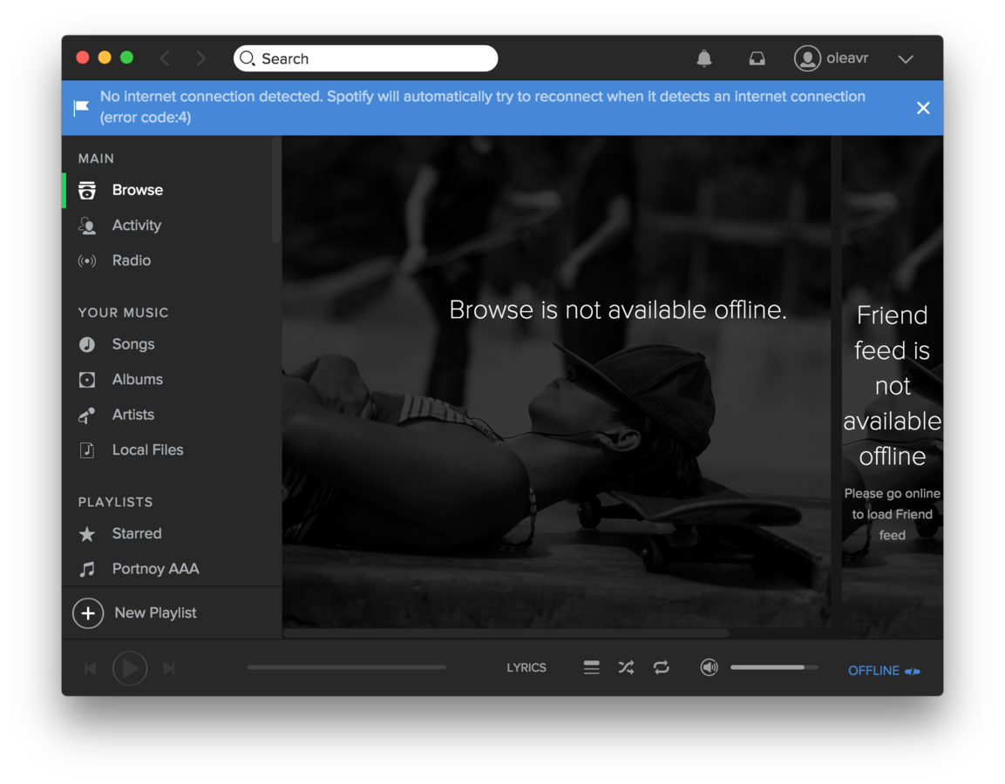
Injecting errors
'use strict’;
const co = require('co');
const frida = require('frida');
const load = require('frida-load');
let session, script;
co(function *() {
session = yield frida.attach(process.argv[2]);
const source = yield load(require.resolve('./agent.js'));
script = yield session.createScript(source);
script.events.listen('message', message => {
console.log(message);
});
yield script.load();
})
.catch(console.error);
$ node app.js Spotify
connect() family=2 ip=78.31.9.101 port=80 blocking!
connect() family=2 ip=193.182.7.242 port=80 blocking! connect() family=2 ip=194.132.162.4 port=443 blocking! connect() family=2 ip=194.132.162.4 port=80 blocking! connect() family=2 ip=194.132.162.212 port=80 blocking! connect() family=2 ip=194.132.162.196 port=4070 blocking! connect() family=2 ip=193.182.7.226 port=443 blocking!
Interceptor.replace(connect,
new NativeCallback((socket, address, addressLen) => {
…
if (port === 80 || port === 443 || port === 4070) {
this.errno = ECONNREFUSED;
return -1;
} else {
return connect(socket, address, addressLen);
}
});

Slide 41
All calls between two recv() calls
'use strict’;
const co = require('co');
const frida = require('frida');
const load = require('frida-load');
co(function *() {
…
yield script.load();
});
$ node app.js Spotify
connect() family=2 ip=78.31.9.101 port=80 blocking! connect() family=2 ip=193.182.7.242 port=80 blocking! connect() family=2 ip=194.132.162.4 port=443 blocking! connect() family=2 ip=194.132.162.4 port=80 blocking! connect() family=2 ip=194.132.162.212 port=80 blocking! connect() family=2 ip=194.132.162.196 port=4070 blocking! connect() family=2 ip=193.182.7.226 port=443 blocking!
'use strict';
…
Stalker.follow({
events: {
call: true
},
onReceive(events) {
blobs.push(events);
if (state === COLLECTING) {
sendResult();
state = DONE;
}
}
});
…

Slide 42
Questions?
Twitter: @oleavr

Slide 43
Thanks!
Please drop by #frida on FreeNode, and don't forget to join our mailing list:
https://groups.google.com/d/forum/frida-dev

